Slide 1

Parking Management System by -: Shubham Raj ( 12109415 ) Mugle Sruthi ( 12109334 )

Slide 2
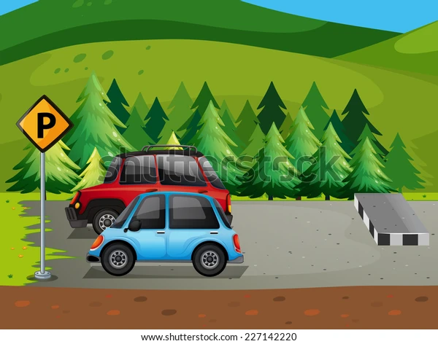
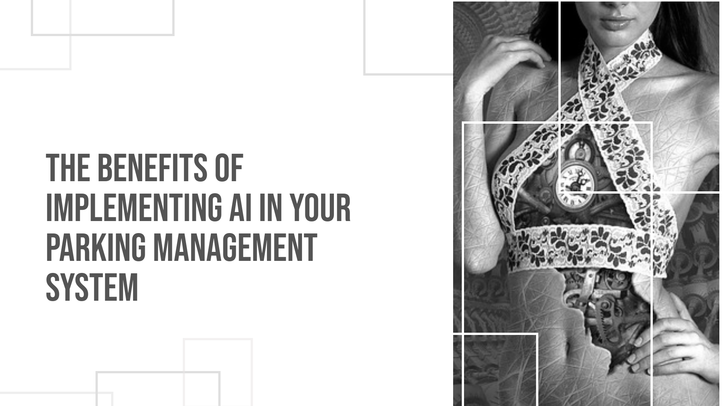

Slide 3
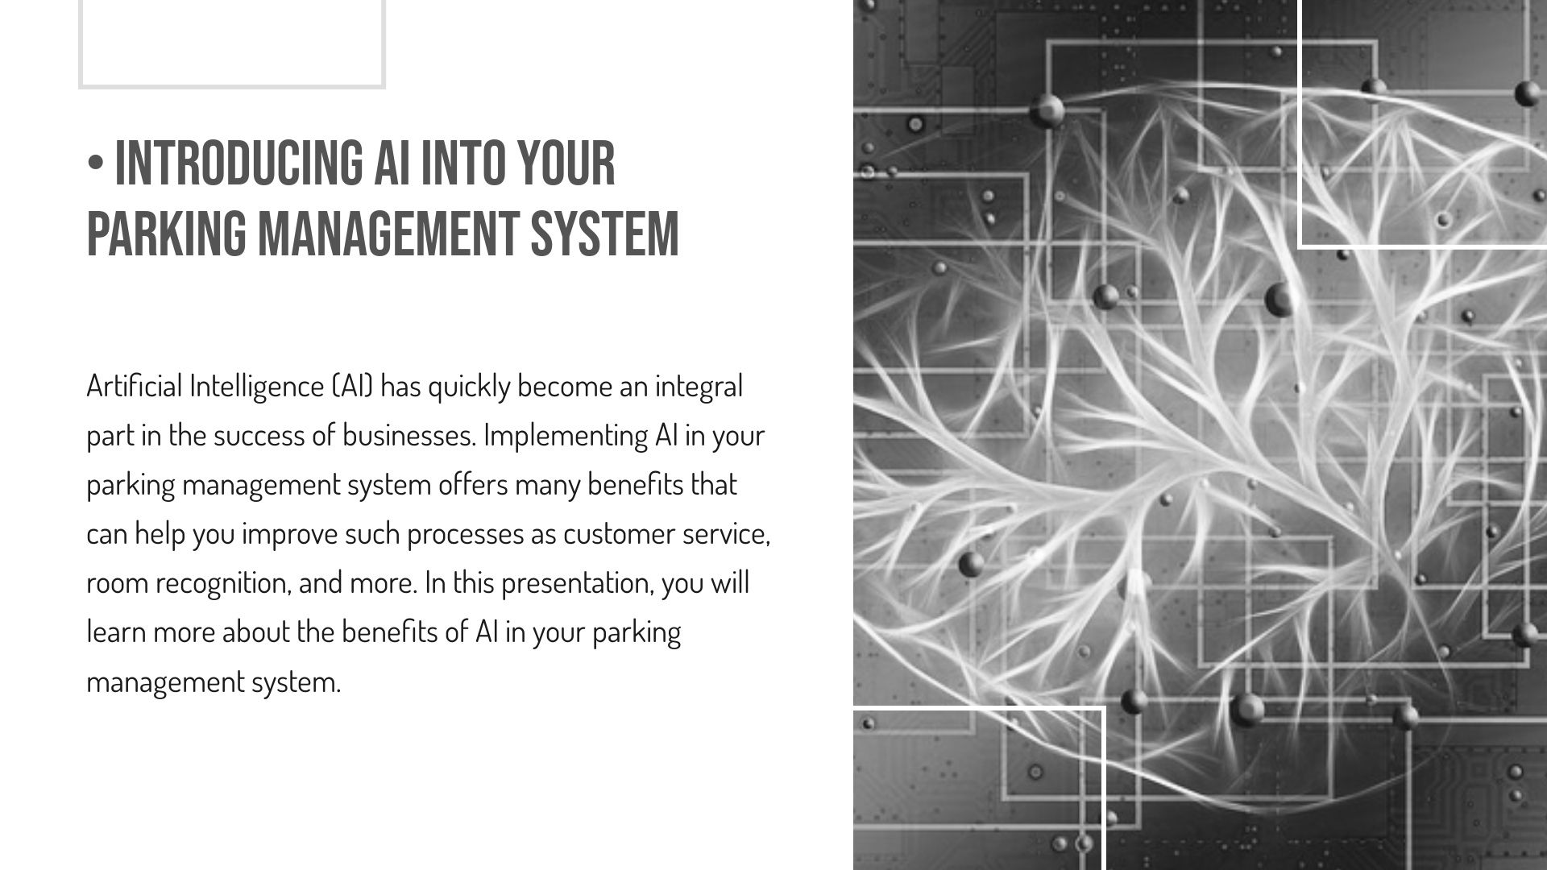

Slide 4
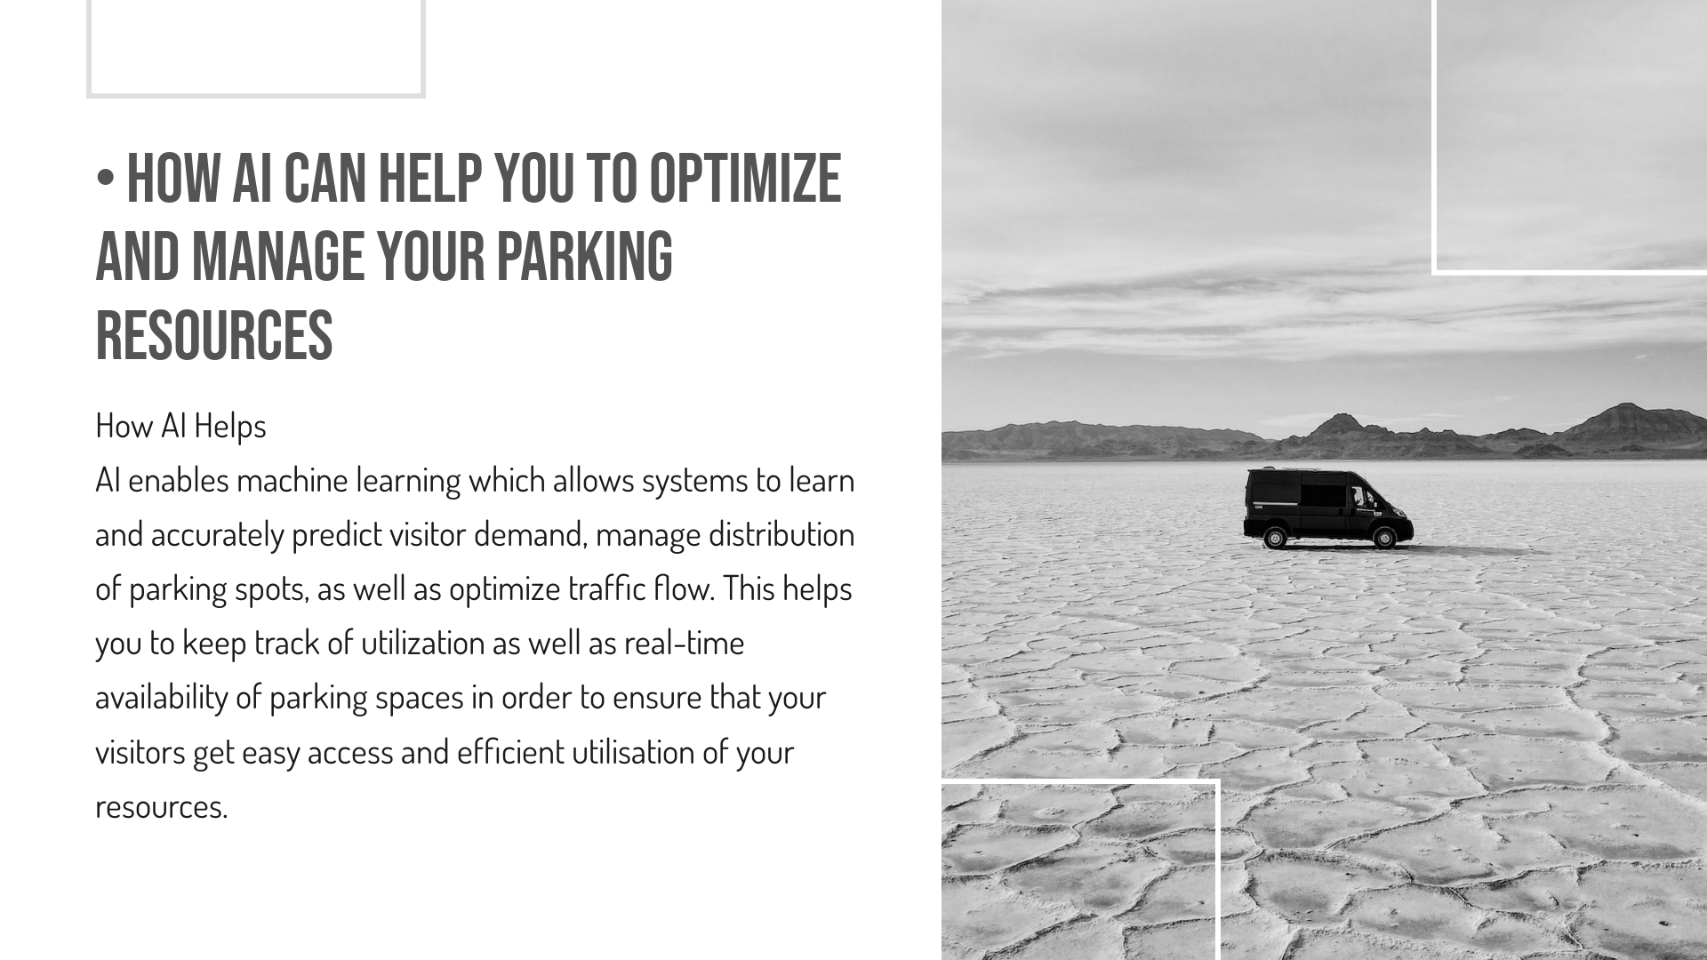

Slide 5

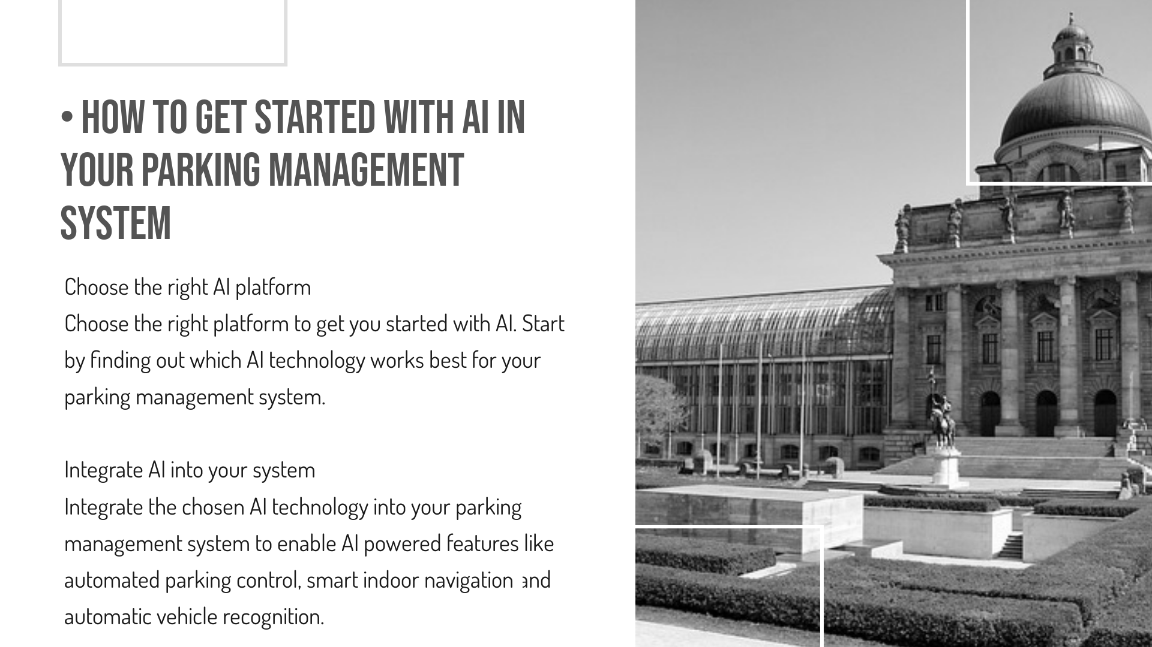

Slide 6
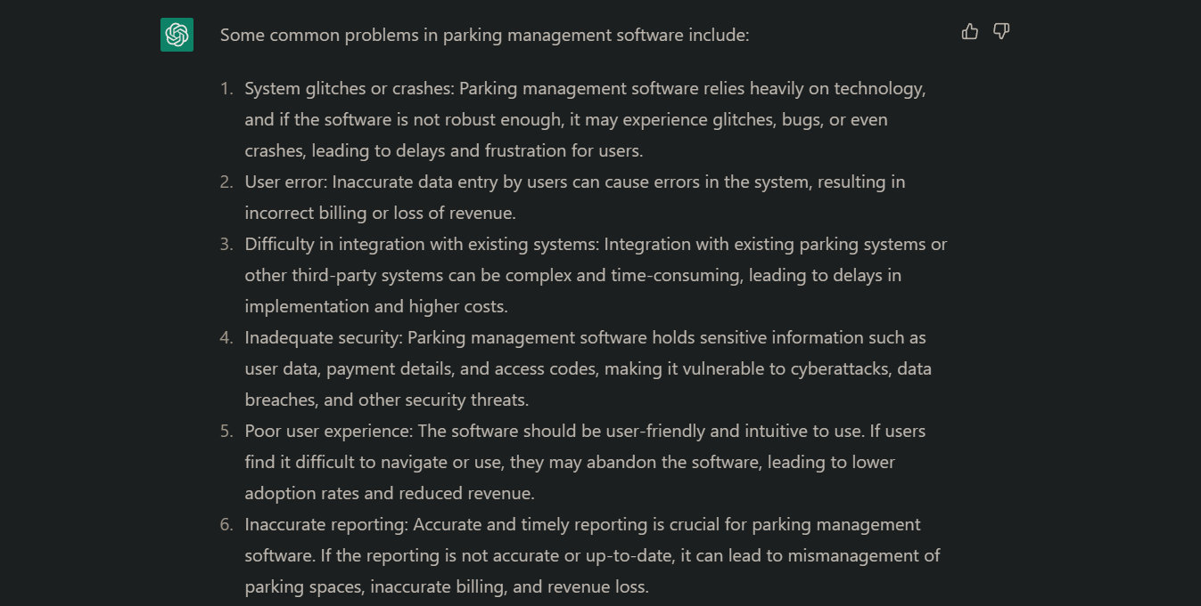

Slide 7
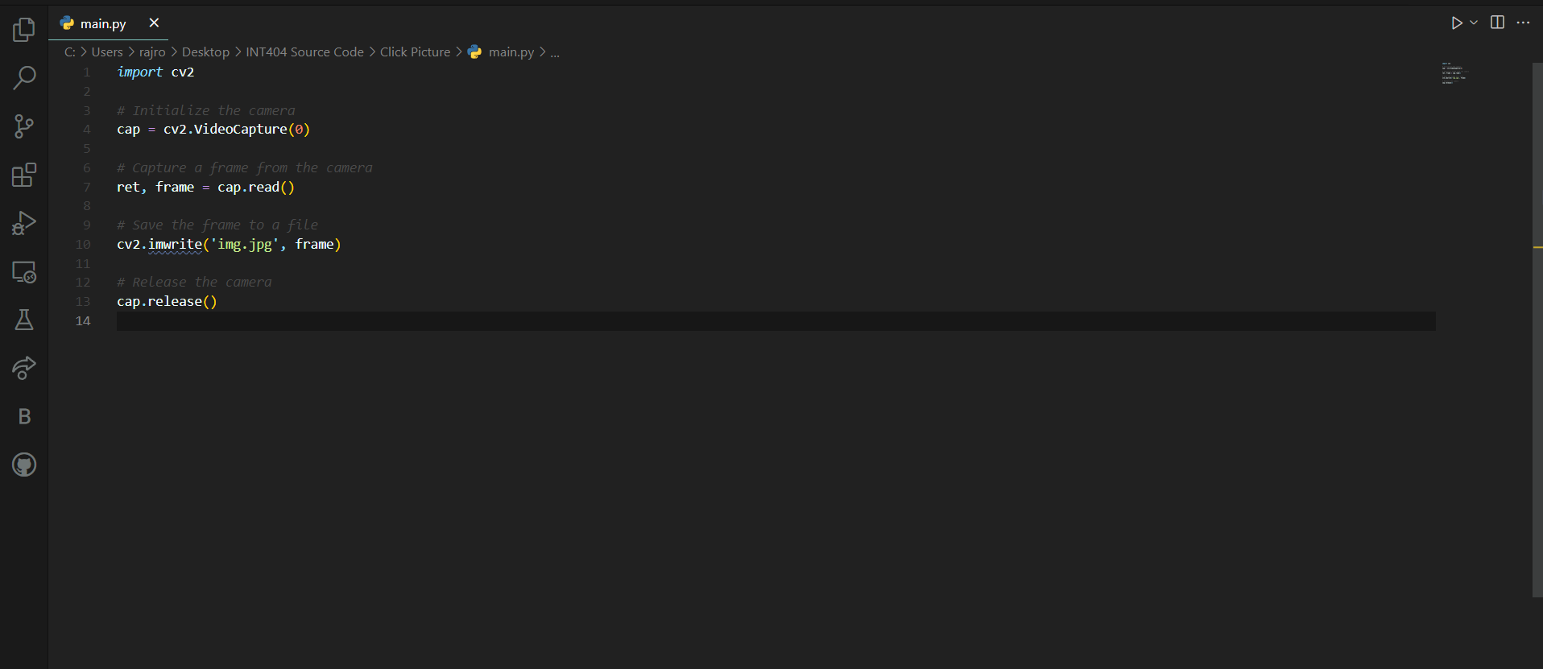

Slide 8
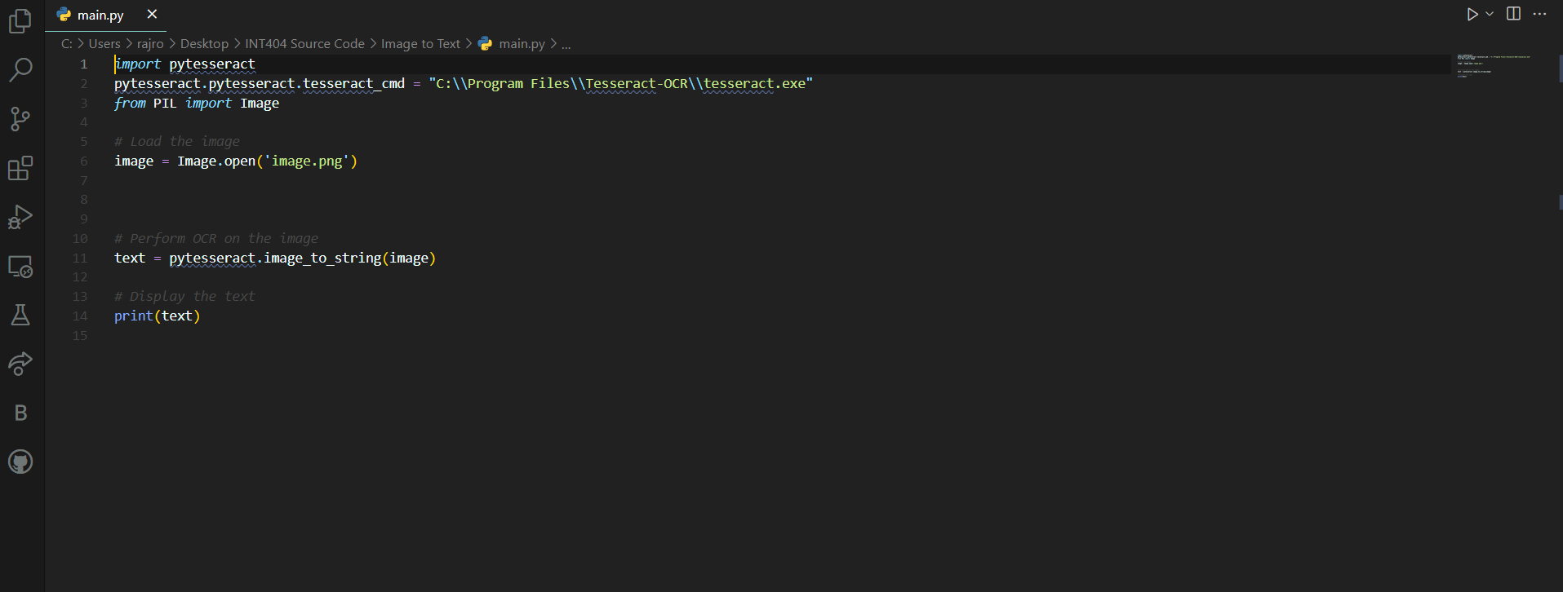

Slide 9
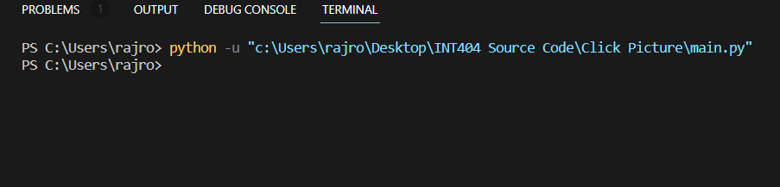
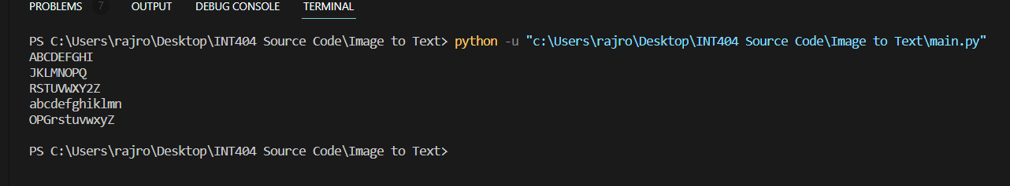

Slide 11


Parking Data Set
https://docs.google.com/spreadsheets/d/1WgXHiZVhNeH7ed_mqE-kvsGcOsWcAPlq2JgOjag4j68/edit?usp=share_link

Slide 12

SOURCE CODE
https://lpuin-my.sharepoint.com/:u:/g/personal/shubham_12109415_lpu_in/EUfTHGPWFERJnPmZNaCZnzcBzoIUDDmgFqm2PSwV--QH8Q?e=sxJMNp

Slide 13

REPORT
https://lpuin-my.sharepoint.com/:b:/g/personal/shubham_12109415_lpu_in/EWordWsOTkFMhaLpKdu105QBikOt_eBCoI8g_0aH9vhJkg?e=DAtoLy

Slide 14
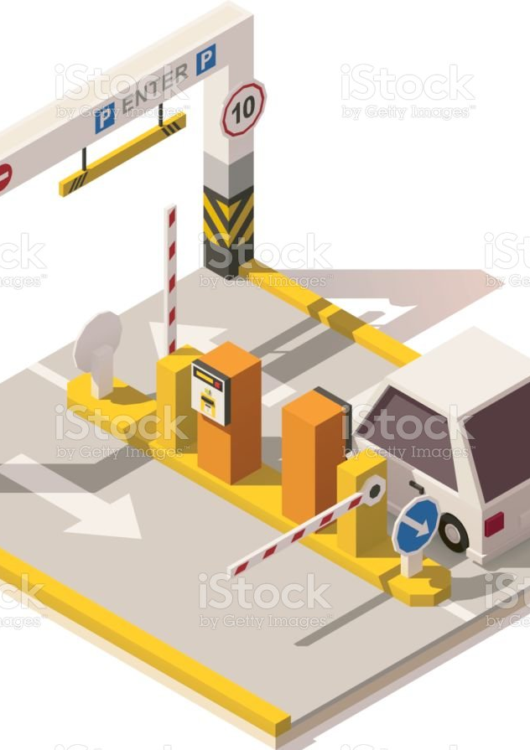


Slide 15
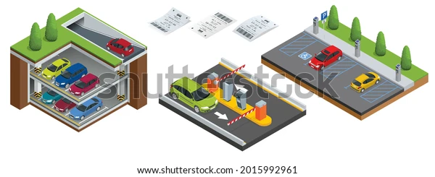

Slide 16


